Slide 1
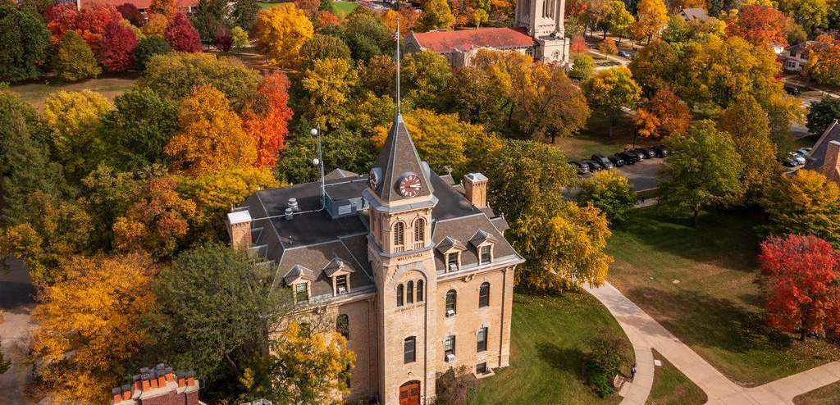
Willis Reconstructed
A Digital Humanities Project by Ronan Thomas, Zander Kim, Kaden Becker, Eli Allen, and Jackson Reade

Slide 2
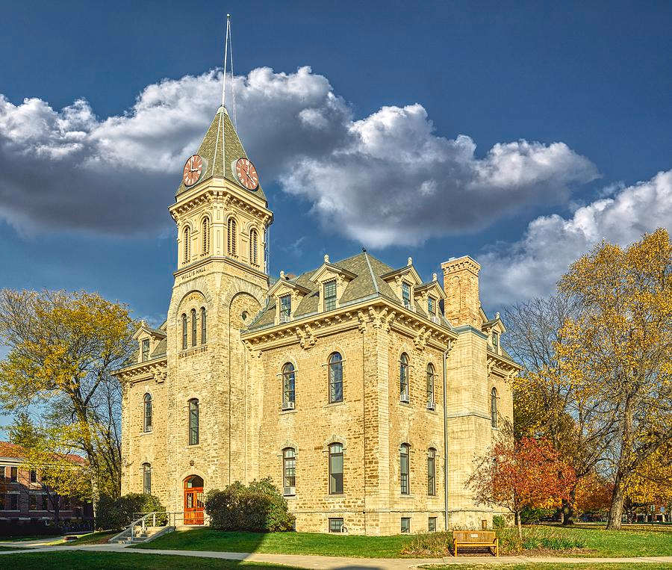
Why Willis Hall?
Notes:
We chose Willis Hall because it is one of the oldest and most recognizable buildings on campus. It has a long history of serving different purposes. We also recently found out that parts of the interior are going to be undergoing renovation, which made this project a good opportunity to document the building as it exists today.

Slide 3
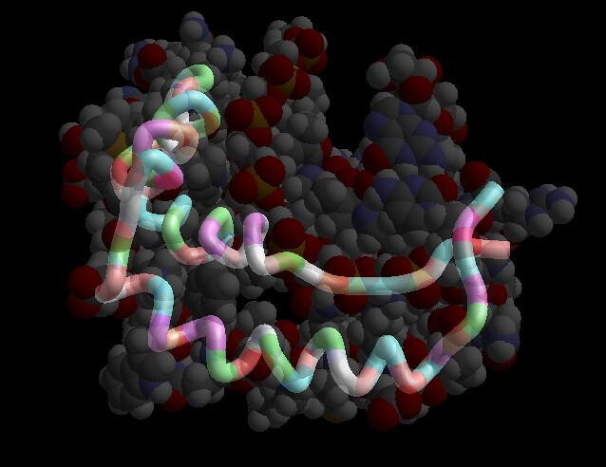
Interactive data presentation

Slide 4




Tools Powering our Project
Notes:
Our project combines several digital tools to build an interactive experience. We used Flourish to build a historical timeline,
PolyCam to capture interior panoramas, Scaniverse to create a 3D splat model of the exterior, and ThingLink to add interactive hotspots to a tour of the building.

Slide 5
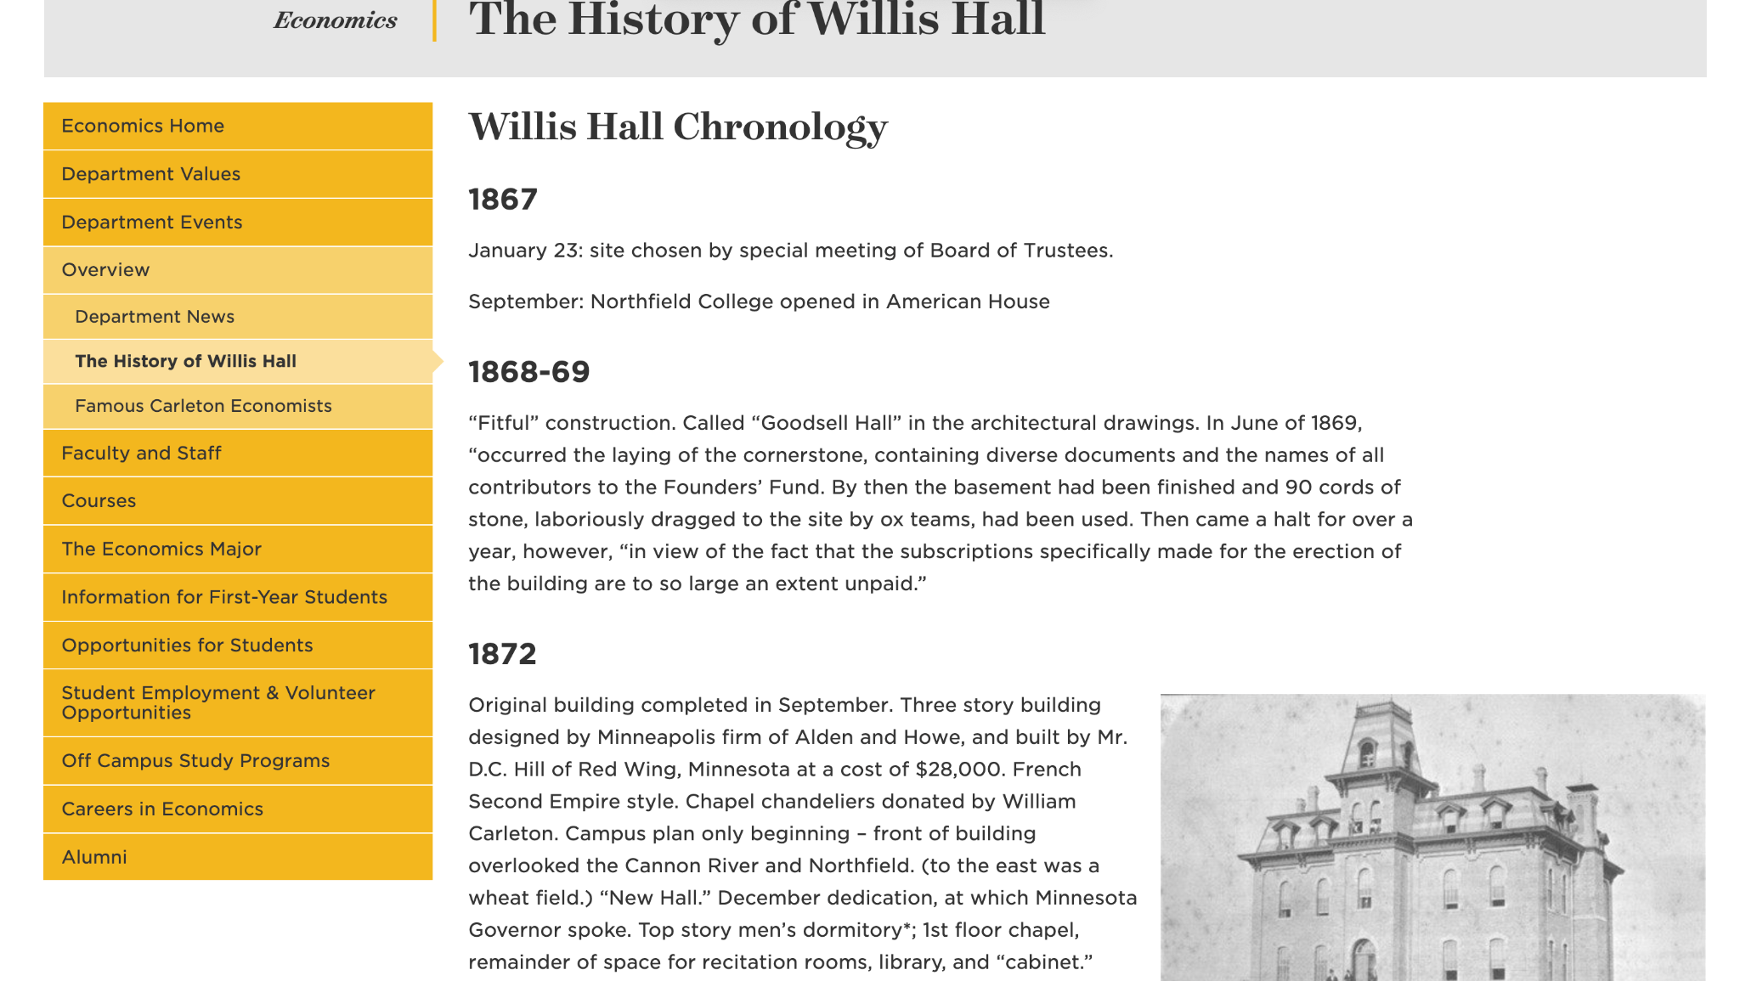
Timeline: Finding the Information
Notes:
KB - Super useful site on Carleton with history dating back to 1867

Slide 6
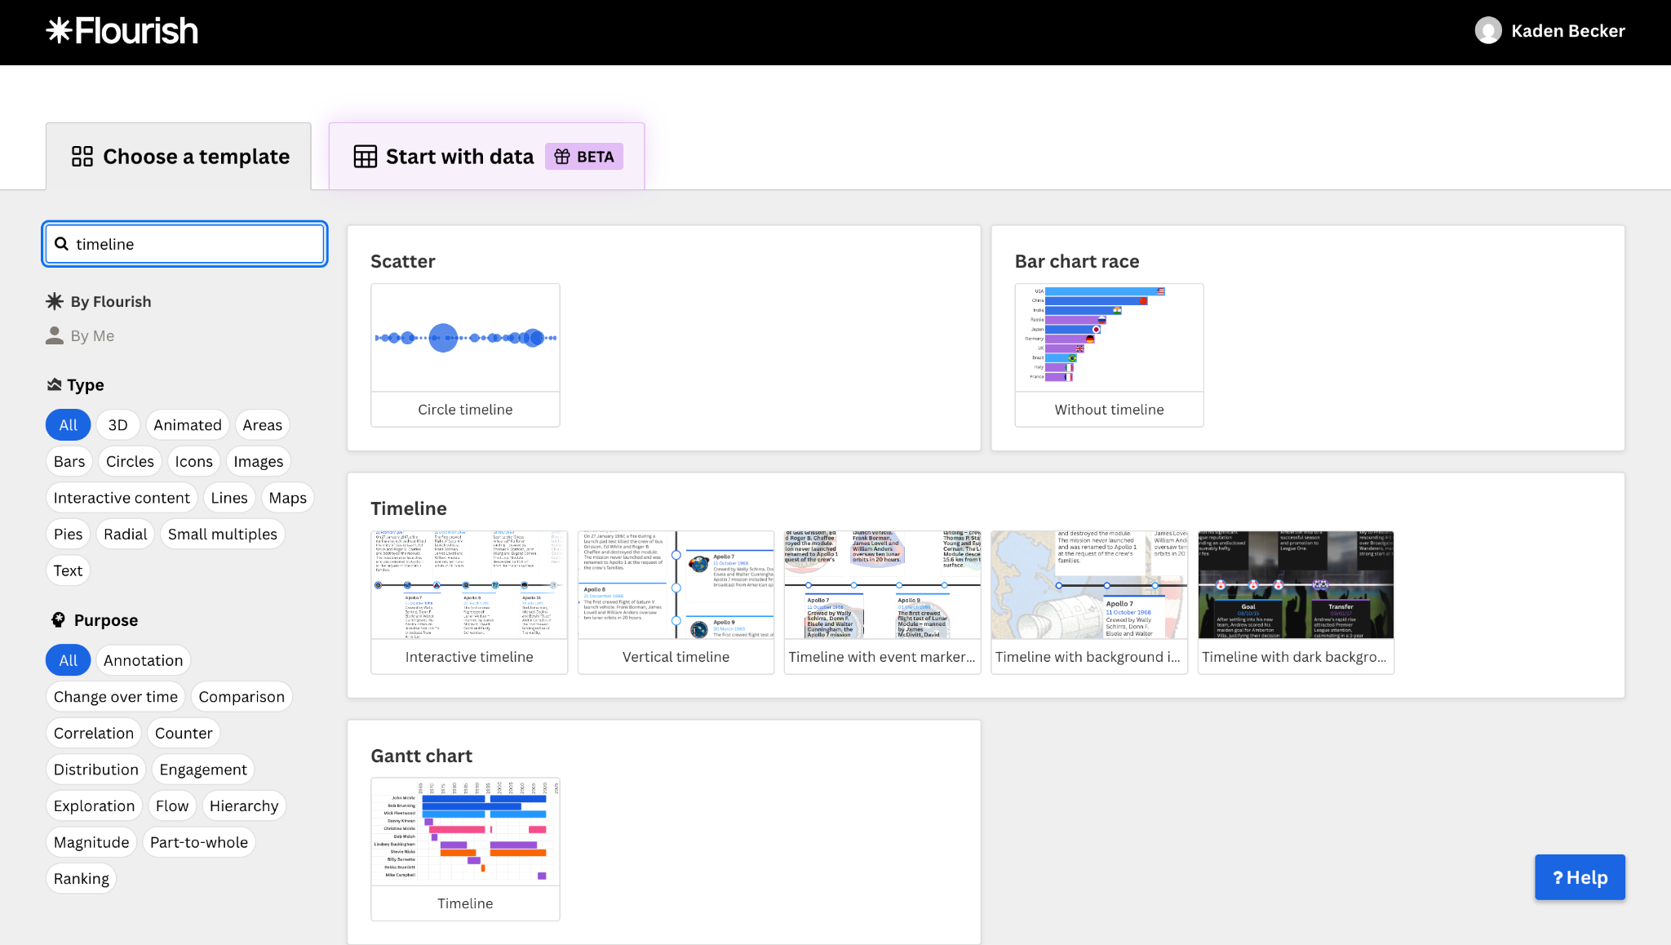
Finding Visualization Type
Notes:
KB - Flourish has so many graph and data viz options, we settled on an interactive timeline

Slide 7
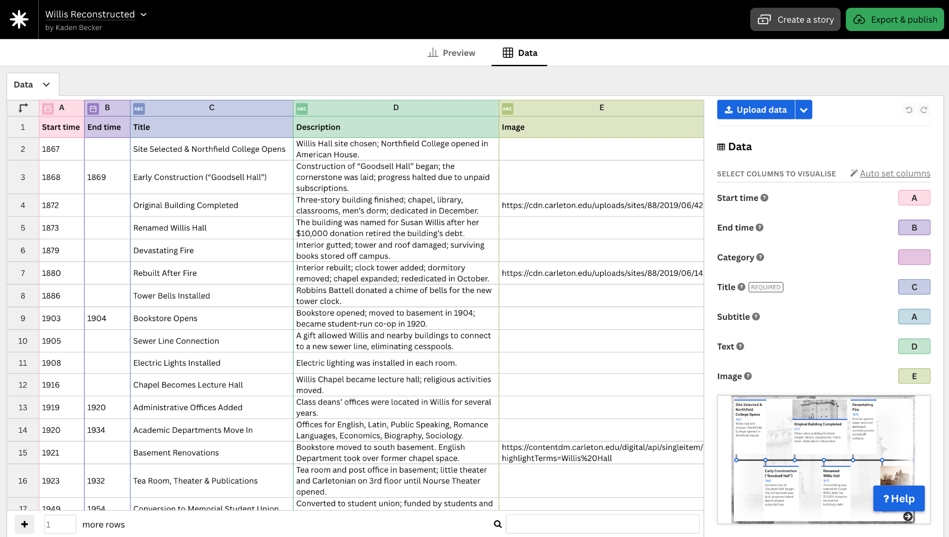
Data Transferring
Notes:
KB - transferred data manually from the website of willis to here, but it could be very easy to have a spreadsheet as well and you can upload it into here for reproducibility.

Slide 8
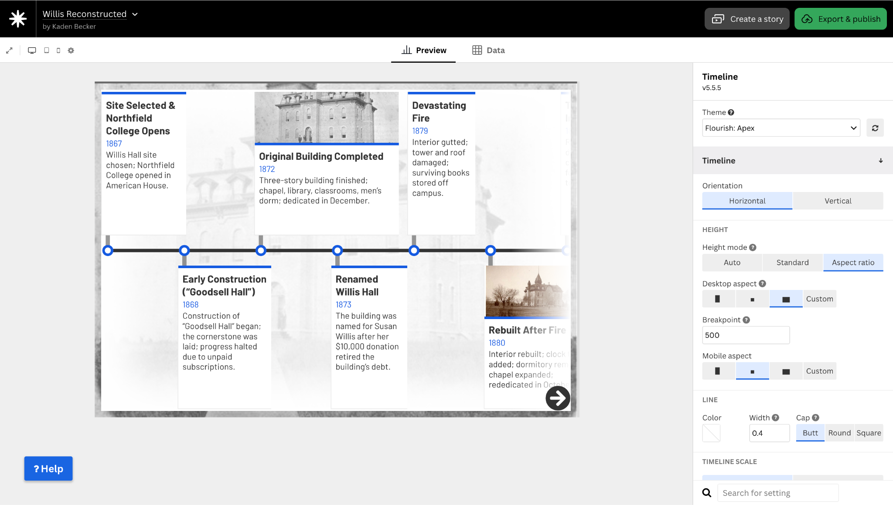
Final Timeline Product and Embedding
Notes:
KB - Customization and perfection, exporting in an easily embeddable way for quick and easy data VIZ.

Slide 9
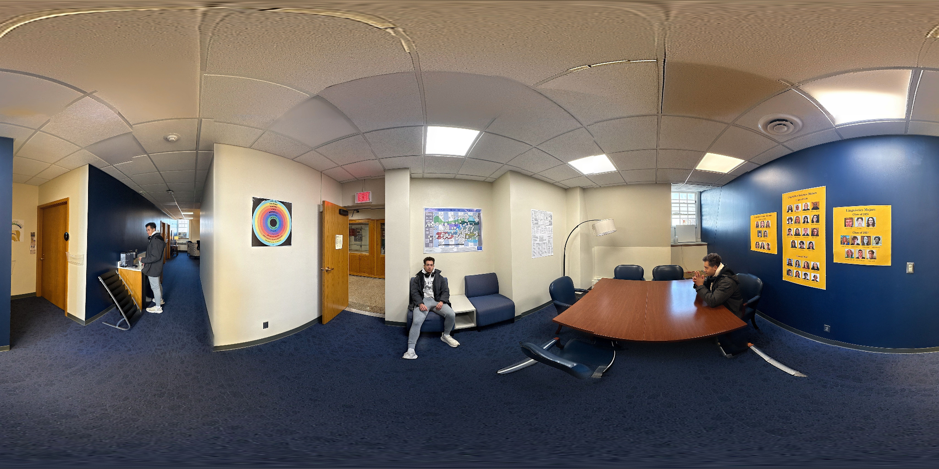
Panoramic Photo Example
Notes:
In order to get the panoramic photos for the thing link tour, we used Polycam. We slowly made a 360 degree turn in each room we scanned to get these photos. The scans are a pretty slow process. We decided to show this in one of the images, where I was able to move to 3 different parts of the room as the camera slowly turned. Once the panoramics were complete they were converted to jpegs and uploaded to Thinglink as images to turn into scenes.

Slide 10
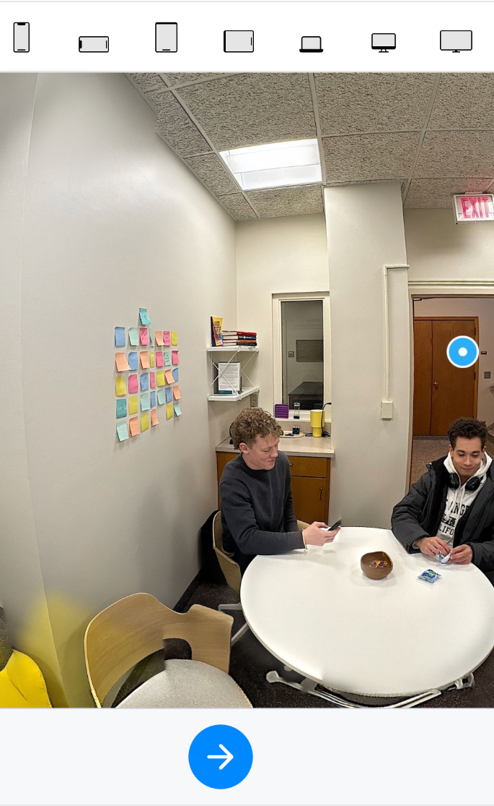
Thinglink Interactive Virtual
Tour
Notes:
We made a virtual tour of the inside of Willis using an interactive media platform called Thinglink. Due to privacy reasons, we did not capture the professor’s offices and most classrooms; however, we were able to scan the main areas and lounges of each floor as well as the staircase leading up and down to them, with floor plans on the top right corner to guide you.

Slide 11
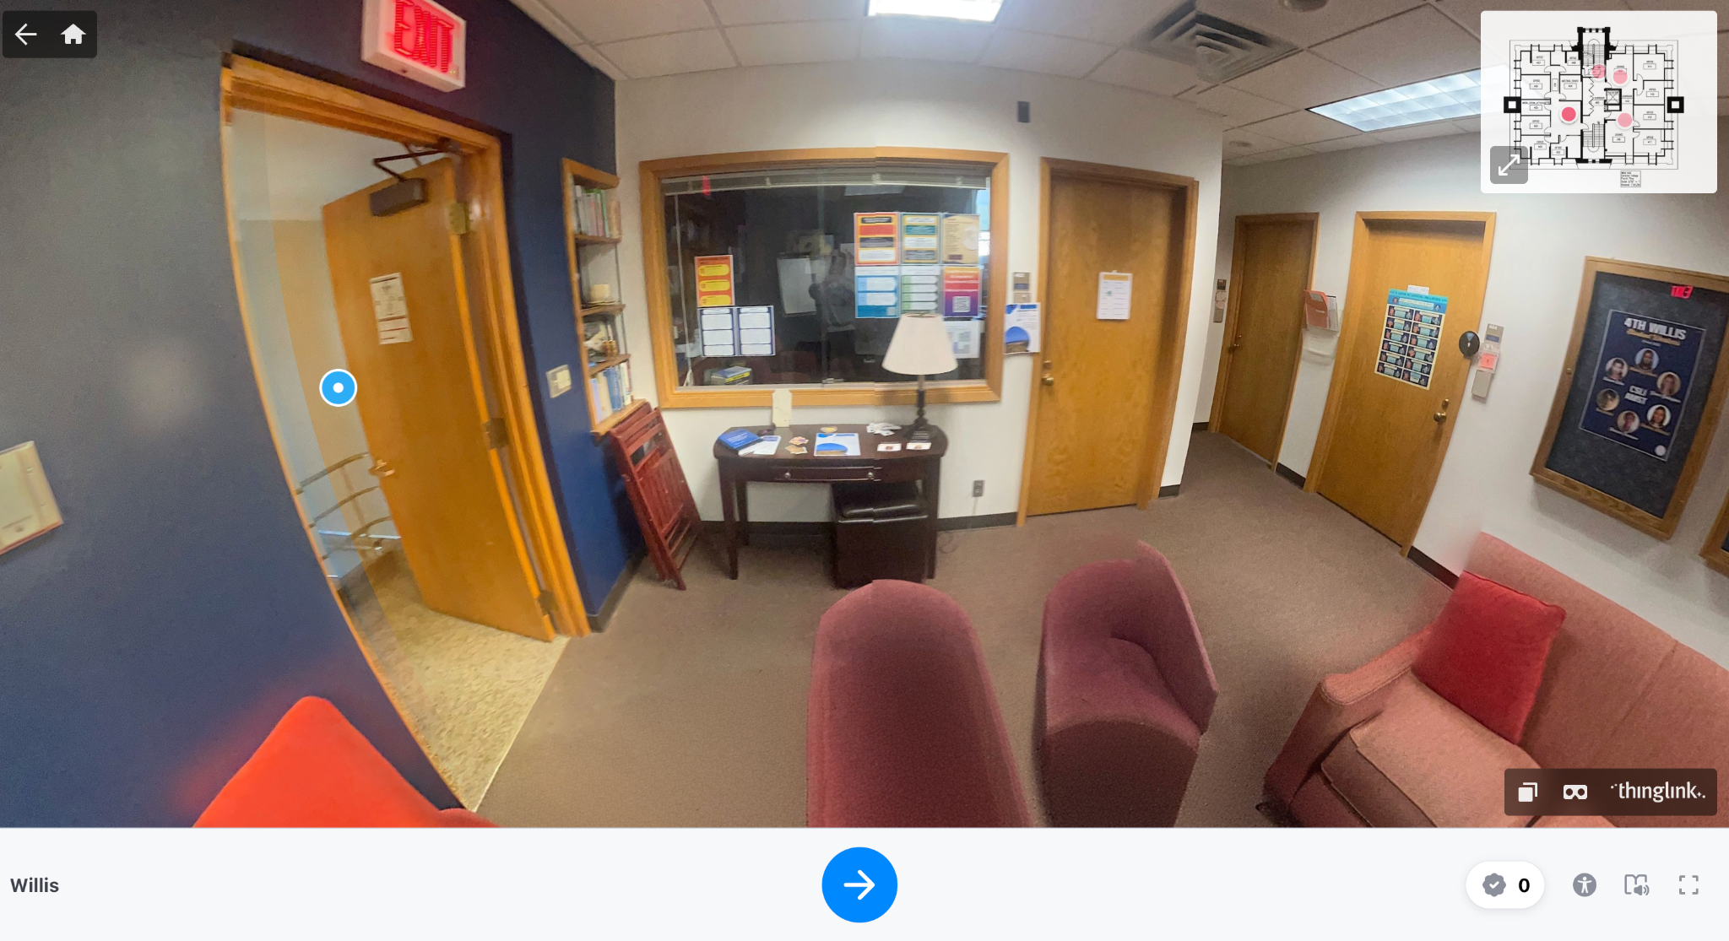
Adding Interactive Floorplans
Notes:
We added interactive floor plans to the ThingLink to allow for even easier navigation. It took some trial and error, but I was able to upload all of the floor plans which I got from Carleton’s website, and was then able to add hotspots.

Slide 12
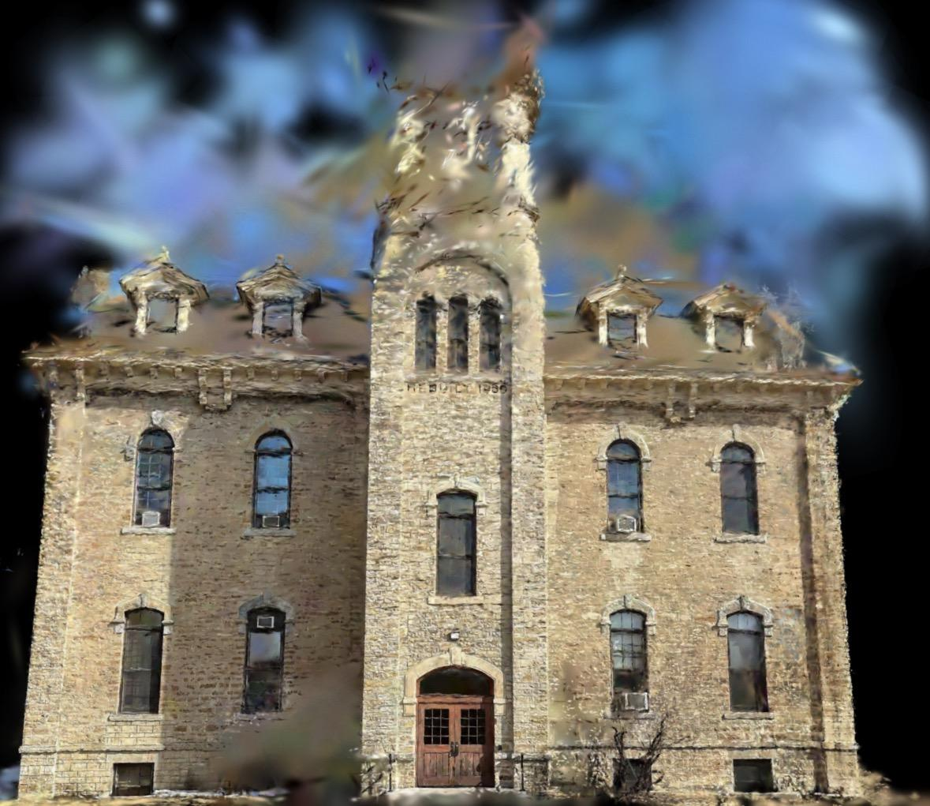
Scaniverse 3D Exterior Splat Model
Notes:
For the exterior of Willis Hall, we created a Gaussian splat model using Scaniverse. This allowed us to capture the full outside of the building in 3D. The model can be rotated and explored directly on our website, giving users a realistic view of the building before entering the interior tour.

Slide 13
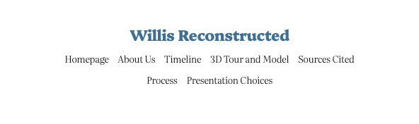
Website Interface (Navigation)

Slide 14
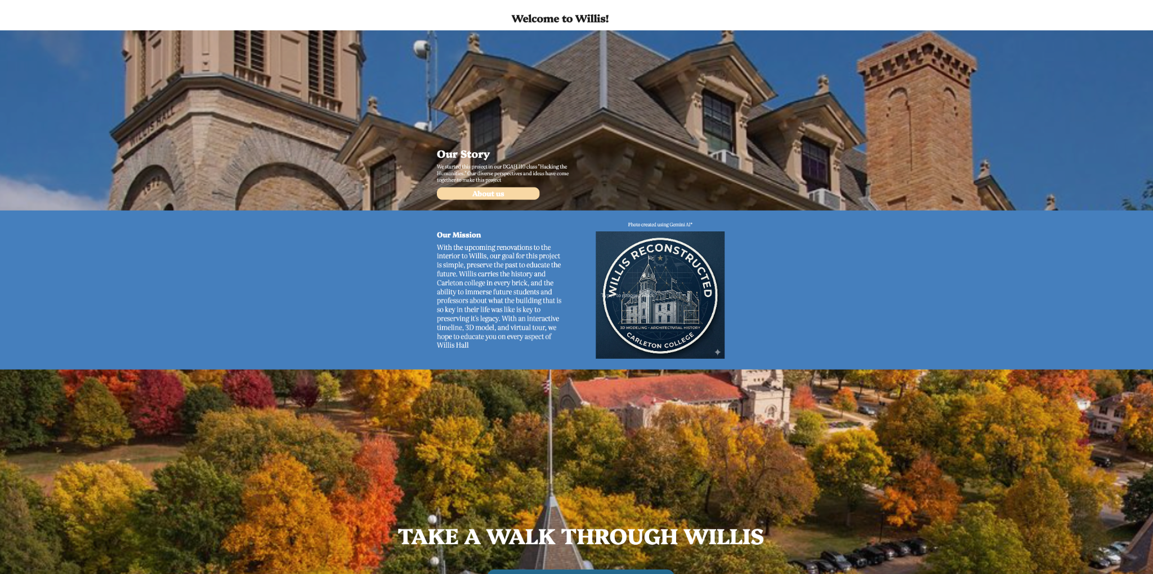
Preview of Final Website

Slide 15
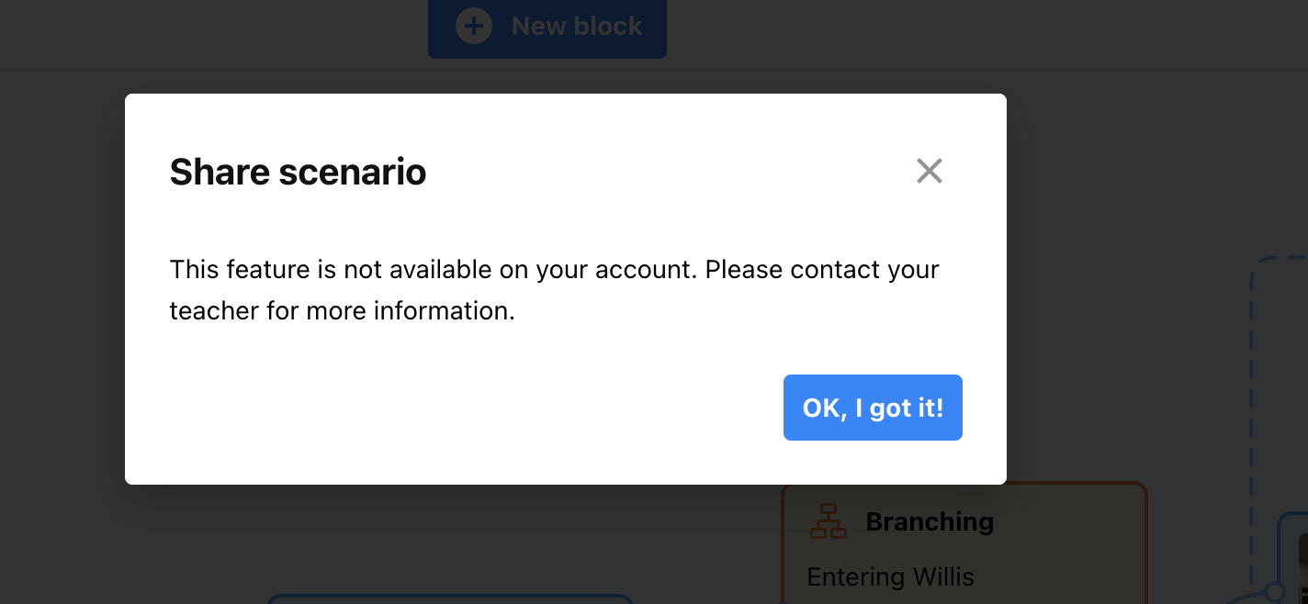
Problems

Slide 16
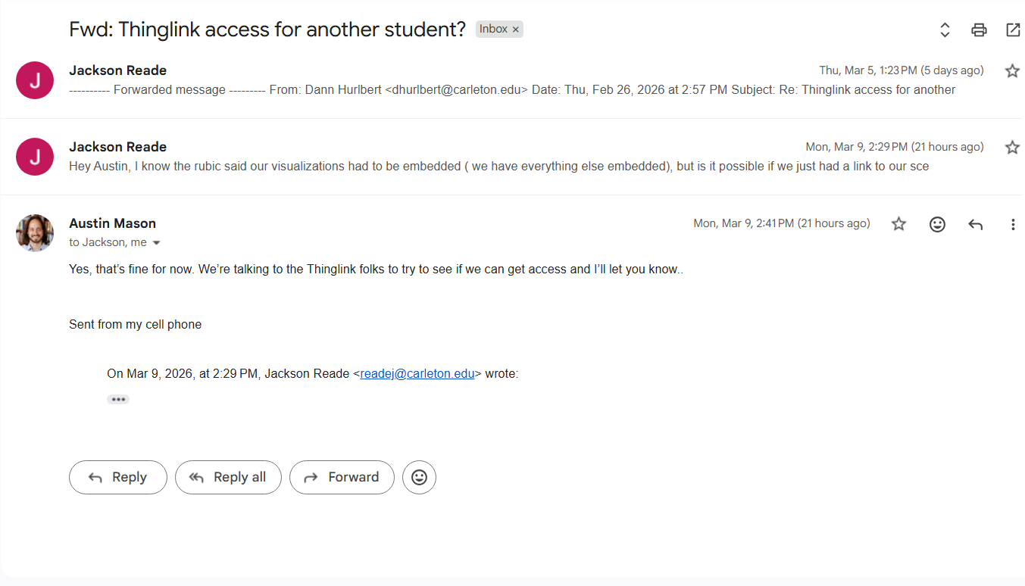
Solutions
Notes:
We contacted Austin about being unable to embed the scenario into the website, and he told us that he is touch with people in charge of the Thinglink license.

Slide 17

What makes our project unique?
Made with Gemini
Notes:
Our project is unique because it takes a historical deep dive into of one of Carleton’s most renowned academic buildings. If you’ve never been inside, you’ve certainly heard the clocktower strike with each passing hour. We hope that with this project you become more educated in the history of Willis Hall with possible renovations coming soon.

Slide 18

Connecting the Project to DGAH

Slide 19
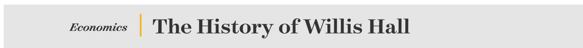
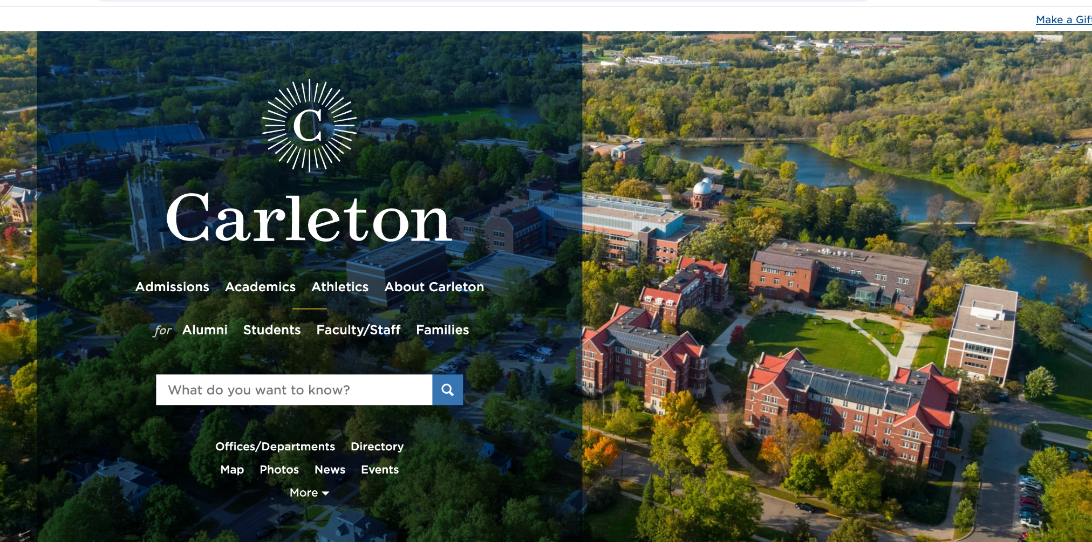
Sources
Sources

Slide 20
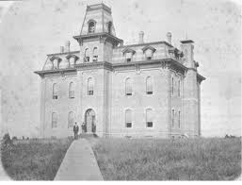
Project Takeaways
Notes:
Through this project, we applied everything we learned in class into making a website dedicated to highlighting the history of Willis Hall. We are proud of the product we made, and can’t wait for you to see the final project.

